Slide 1
6CS005 High Performance Computing
Lecture 3 OpenMP

Slide 2
OpenMP- What is it?
OpenMP stands for Open Multi-Processing.
It is an API that supports shared memory multiprocessing programming in C, C++ and Fortran.
OpenMP was defined by the OpenMP Architecture Review Board (OpenMP ARB), a group of vendors who joined forces during the 1990s to provide a common means for programming a broad range of SMP architectures.
OpenMP is not a new programming language. It can be considered as a “notation” that can be added to a sequential program in Fortran, C or C++ to describe how the work is to be shared among threads that will execute on different processors/cores, and to order accesses to shared data as needed.

Slide 3
OpenMP- What is it?
The OpenMP Application Programming Interface (API) was developed to enable portable shared memory parallel programming.
An OpenMP directive is an instruction in a special format that is only understood by OpenMP-aware compilers.
OpenMP offers a shared memory programming model, where most variables are visible to all threads by default.

Slide 4
OpenMP Goals
OpenMP is designed to be a portable, scalable model that gives programmers a simple and flexible interface for developing parallel applications.
The API is designed to permit incremental approach to parallelizing an existing code, possibly in successive steps.
The impact of OpenMP parallelization is frequently localized, i.e. modifications are often needed in few places.
It is possible to write the code such that the original sequential version is preserved.
Each thread execute a parallelized section of code independently.

Slide 5
OpenMP Solution Stack
User layer
End User
End User
Application
Prog. Layer
Directives, Compiler
OpenMP library
Environment
Variables
System layer
OpenMP Runtime library
OS/system support for shared memory and threading
Proc1 Proc₂ Proc₃ ProcN
HW
Shared Address Space

Slide 6
How it works
OpenMP is an implementation of multithreading, where a master thread forks a specified number of slave threads and a task is divided among them.
The main approach is based in identifying the parallelism in the program, and not in reprogramming the code to implement the parallelism.
The section of code that is meant to run in parallel is marked with a preprocessor directive.
Each thread has a unique identifier called a thread id, where the master thread has an id of 0.
Both task and data parallelism can be achieved using OpenMP by using work-sharing constructs to divide a task.

Slide 7
OpenMP Fork/Join Model
{
The program starts as a single thread just like a sequential program. The thread that executes this code is referred to as the initial thread.
Fork
{
{
Whenever an OpenMP parallel construct is encountered, a team of threads is created (fork). The initial thread becomes the master of the team. They all execute the code enclosed in the construct.
Parallel region
Join
{
At the end of the construct, only the original thread continues and all other terminate (join).

Slide 8

OpenMP Programming Model
Fork-Join Parallelism:
Master thread spawns a team of threads as needed.
Parallelism added incrementally until performance goals are met: i.e. the sequential program evolves into a parallel program.
Parallel Regions
A Nested Parallel
Master Thread in red
region
Sequential Parts

Slide 9
OpenMP API
Language Extensions/
Compiler directives/
Constructs
The OpenMP API provides directives, library functions and environment variables to create and control the execution of parallel programs.
User-level runtime routines
Environment
Variables
header file <omp.h>
Notes:
DONE

Slide 10
OpenMP Core elements
The core elements of OpenMP are the constructs for thread creation, workload distribution (work sharing), data environment variables, thread synchronization, user-level runtime routines and environment variables.
OpenMP Core Elements
parallel control
structures
work sharing
data
environment
synchronization
runtime functions,
env variables
governs flow of control in the program
parallel directive
distributes work among threads
do/parallel do
and
section directives
scopes
variables
shared and private clauses
coordinates thread execution
critical, atomic and barrier directives
runtime environment
omp_set_num_threads()
omp_get_thread_num()
OMP_NUM_THREADS
OMP_SCHEDULE
Notes:
DONE

Slide 11
OpenMP Directive
General form of an OpenMP directive
Parallel construct
    #pragma omp directive-name [clause[[,] clause]...] new-line
    #pragma omp parallel [clause[[,] clause]...]
    {
    /* parallel section */
    }

Slide 12
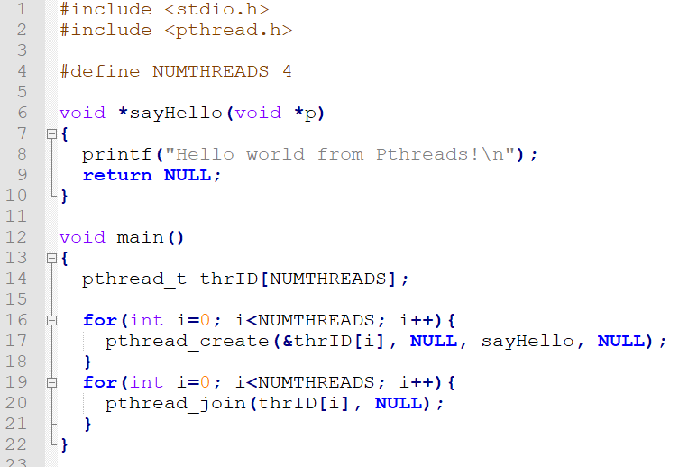
Pthread Hello World example

Slide 13
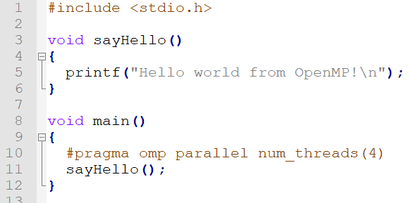
OpenMP Hello World example

Slide 14
OpenMP Hello World with specified threads

Slide 15
Single Threaded Prime Numbers
#include <stdio.h>
void main()
{
int i, c;
int nstart=1, nfinish=20000;
printf("Prime numbers between %d and %d are :\n", nstart, nfinish);
for(i=nstart; i<=nfinish; i++){
for(c = 2; c <= i-1; c++){
if ( i%c == 0 )
break;
}
if ( c == i )
printf("%d\n", i);
}
}

Slide 16
Multithreaded Version - 2 threads
#include <stdio.h>
#include <pthread.h>
void *threadOne(void *p){
int i, c;
int nstart=1, nfinish=10000;
for(i=nstart; i<=nfinish; i++){
for(c=2; c <= i-1; c++){
if ( i%c == 0 )
break;
}
if ( c == i )
printf("threadOne : %d\n", i);
}
return 0;
}
void main(){
pthread_t thrID1, thrID2;
printf("threadOne : Prime numbers between %d and %d are :\n", nstart, nfinish);
pthread_create(&thrID1, NULL, threadOne, NULL);
pthread_create(&thrID2, NULL, threadTwo, NULL);
pthread_join(thrID1, NULL);
pthread_join(thrID2, NULL);
}
void *threadTwo(void *p){
int i, c;
int nstart=10001, nfinish=20000;
for(i=nstart; i<=nfinish; i++){
for(c=2; c<=i-1; c++){
if ( i%c==0 )
break;
}
if ( c==i )
printf("threadTwo : %d\n", i);
}
return 0;
}

Slide 17
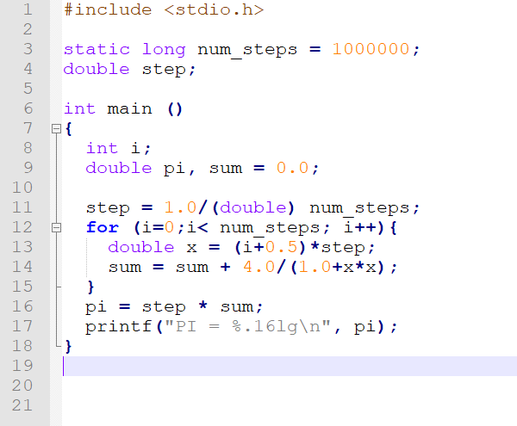
Calculating PI

Slide 18
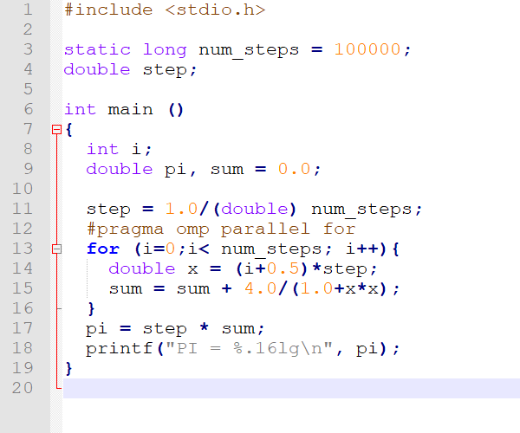
OpenMP PI

Slide 19
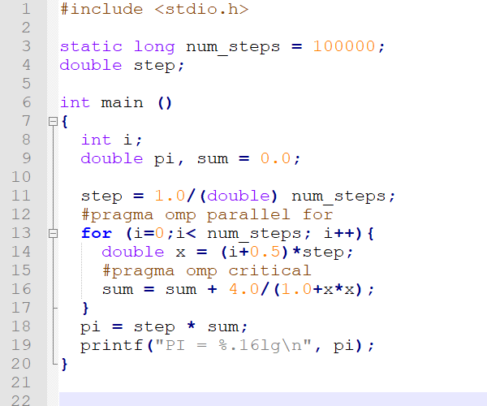
OpenMP PI Critical Section

Slide 20
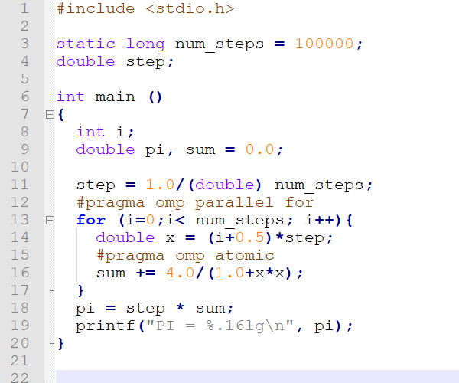
OpenMP PI Atomic Operation

Slide 21
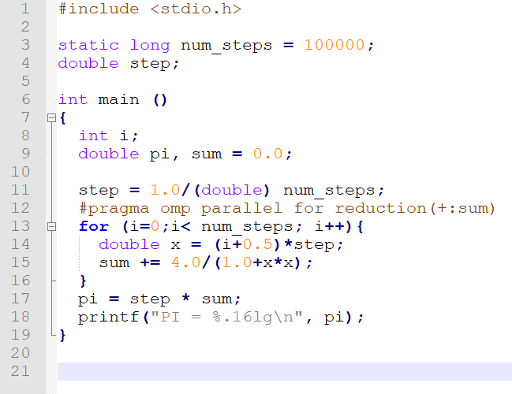
OpenMP PI Reduction Operation

Slide 22
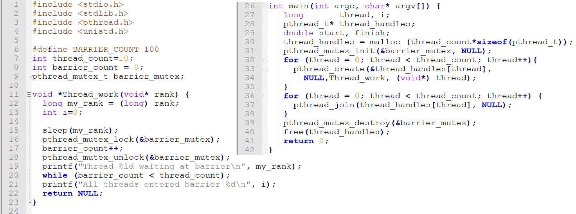
Pthread Barrier

Slide 23
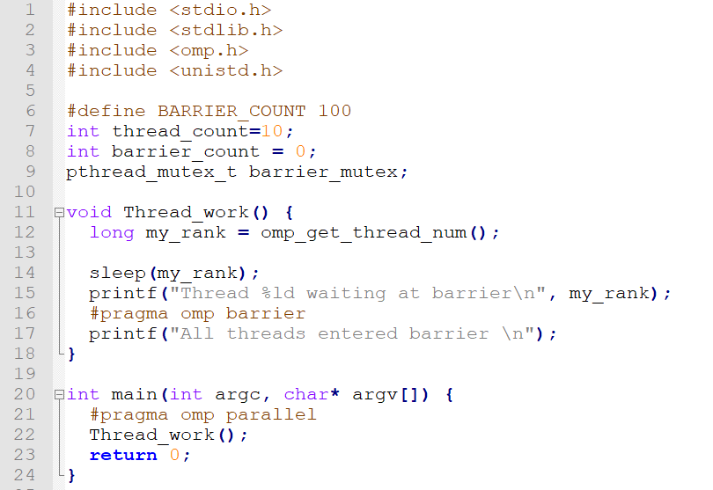
OpenMP Barrier

Slide 24
To be continued

